Slide 1
Slaviša Đurđić
World Bank Population
Goal: Analysis of the World Bank population dataset by country and year.
Instructions:
- Collect data from the "bigquery-public-data.world_bank_global_population.population_by_country " dataset available on BigQuery.
- Load the data to MySQL table(s).
- Build visuals in Power BI Desktop.
Belgrade, August 2023

Slide 2

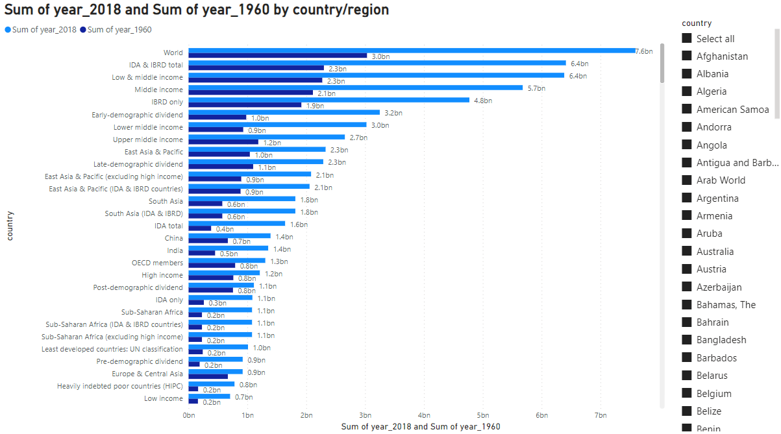
Microsoft Power BI

Slide 3
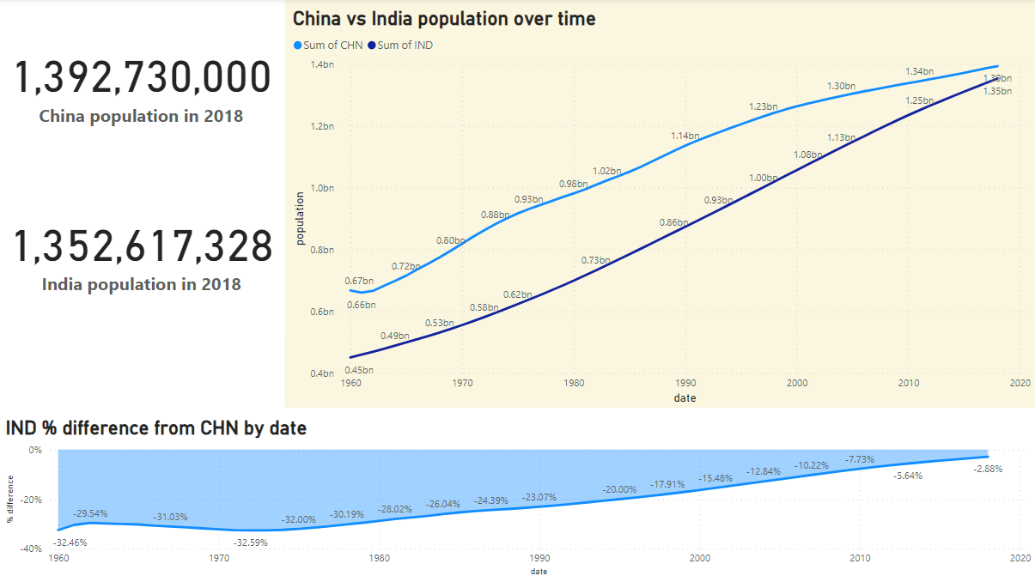
Microsoft Power BI

Slide 4
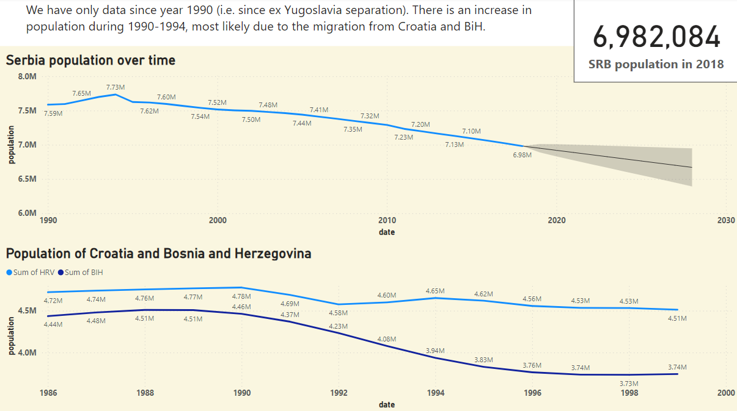
Microsoft Power BI

Slide 5
World Population Project Insights
1) World population more than doubled in last 50 years.
2) China and India make 1/3 of the world population.
3) Given the population growth rate and population stats in year 2018 (less than 3% of difference), India will surpass China in few years.
4) Population in Serbia constantly decline for the last 30 years (exception is period 1990-1994).

